Slide 1


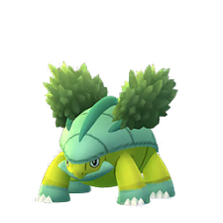
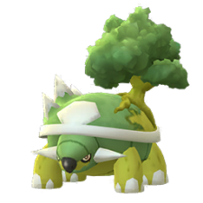
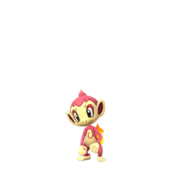
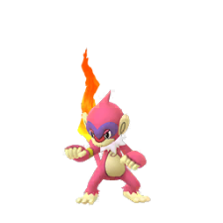
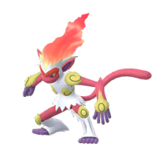

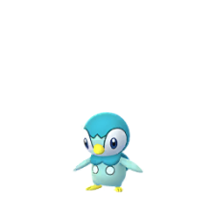
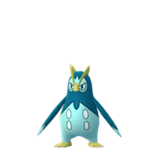
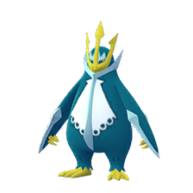

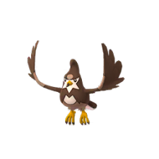
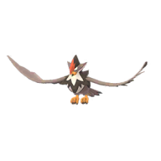
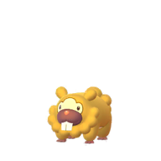
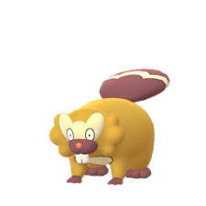

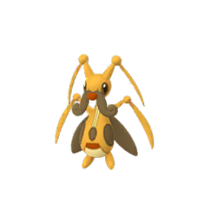
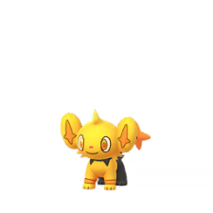
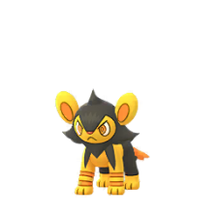
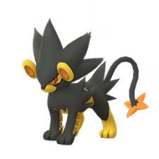


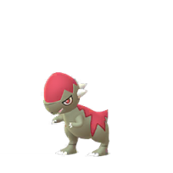
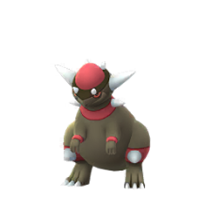
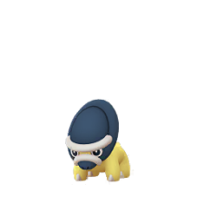
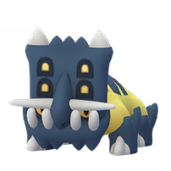
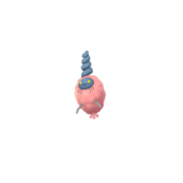
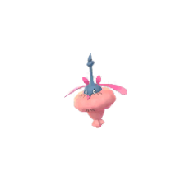




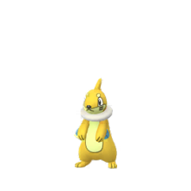
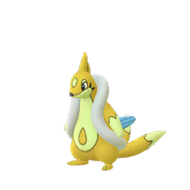


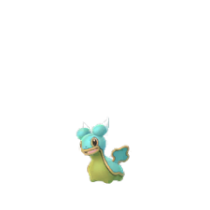
Pokemon Go : Shiny Check List
Generation 4 ( Sinnoh )
Turtwig
Grotle
Torterra
Chimchar
Monferno
Infernape
Piplup
Prinplup
Empoleon
Starly
Staravia
Staraptor
Bidoof
Bibarel
Kricketot
Kricketune
Shinx
Luxio
Luxray
Budew
Roserade
Cranidos
Rampardos
Shieldon
Bastiodon
Burmy
Wormadam
Mothim
Combee
Vespiquen
More On Page 4
More On Page 4
Pachirisu
Buizel
Floatzel
Cherubi
Cherrim
Shellos
More On Page 4
More On Page 4
Page 1 of 5

Slide 2
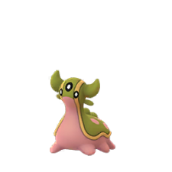
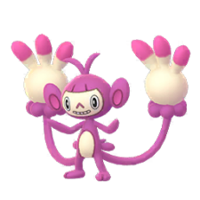

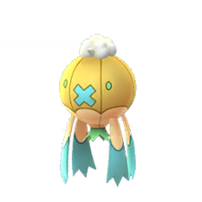
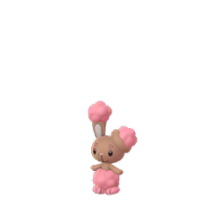
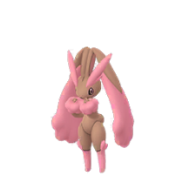
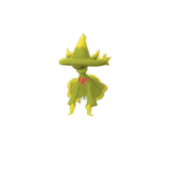

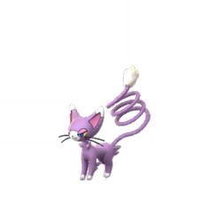
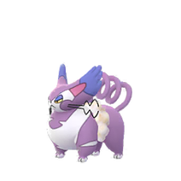

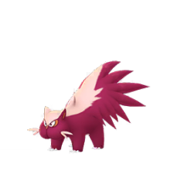
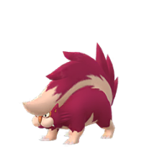


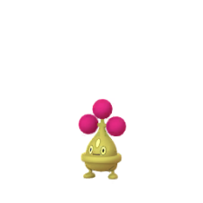
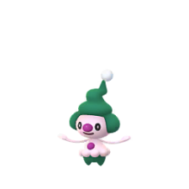

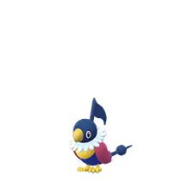
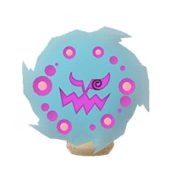
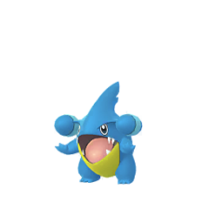
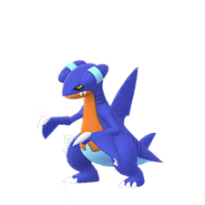
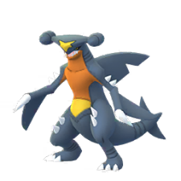
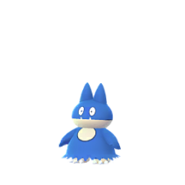
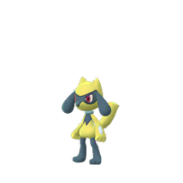
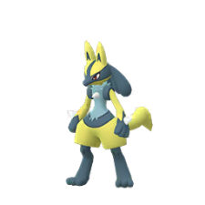
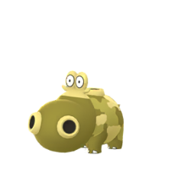
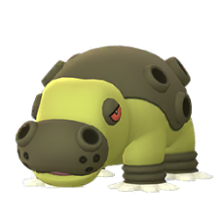
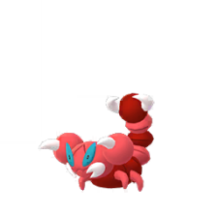
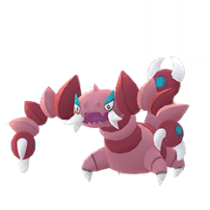
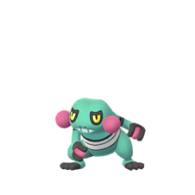





Pokemon Go : Shiny Check List
Generation 4 ( Sinnoh )
Gastrodon
Ambipom
Drifloon
Drifblim
Buneary
Lopunny
MEGA On Page 5
Mismagius
Honchkrow
Glameow
Purugly
Chingling
Stunky
Skuntank
Bronzor
Bronzong
Bonsly
Mime Jr
Happiny
Chatot
Spiritomb
Gible
Gabite
Garchomp
Munchlax
MEGA On Page 5
Riolu
Lucario
Hippopotas
Hippowdon
Skorupi
Drapion
MEGA On Page 5
Croagunk
Toxicroak
Carnivine
Finneon
Lumineon
Mantyke
Page 2 of 5

Slide 3



































Pokemon Go : Shiny Check List
Generation 4 ( Sinnoh )
Snover
Abomasnow
Weavile
Magnezone
Lickilicky
Rhyperior
MEGA On Page 5
Tangrowth
Electivire
Magmortar
Togekiss
Yanmega
Leafeon
Glaceon
Gliscor
Mamoswine
Porygon-Z
Gallade
Probopass
MEGA On Page 5
Dusknoir
Froslass
Rotom
Uxie
Mesprit
Azelf
More On Page 4
Dialga
Palkia
Heatran
Regigigas
Giratina
Cresselia
More On Page 5
Phione
Manaphy
Darkrai
Shaymin
Arceus
More On Page 5
More On Page 5
Page 3 of 5

Slide 4


















Pokemon Go : Shiny Check List
Generation 4 ( Sinnoh )
Others
Burmy & Wormadam
Plant
Sandy
Trash
Plant
Sandy
Trash
Cherrim
Sunny
Overcast
Shellos & Gastrodon
East
West
East
West
Rotom
Normal
Frost
Fan
Mow
Wash
Heat
Page 4 of 5

Slide 5
























Pokemon Go : Shiny Check List
Generation 4 ( Sinnoh )
MEGA & Other’s
Mega’s
Lopunny
Garchomp
Lucario
Abomasnow
Gallade
NO SPRITE
NO SPRITE
NO SPRITE
Shaymin
Giratina
Sky
Land
Altered
Origin
Arceus
Normal
Bug
Dark
Dragon
Electric
Fairy
Fighting
Fire
Flying
Ghost
Grass
Ground
Ice
Poison
Psychic
Rock
Steel
Water
Page 5 of 5

